Slide 1
Problem Solving
Miss L
Year 7

Slide 2
Learning Intentions
Students will be able to
How to solve logical problems

Slide 3
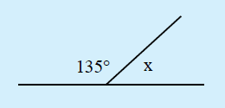

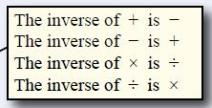

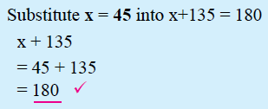
24
7
30
Problem Solving
Date:
EQ – How can we solve logical problems?
Problem: Solve for x
Step 1: Write out an equation
Step 2: Solve the equation
Step 3: Check your answer!
What are the steps to solving a problem?

Slide 4


Slide 5
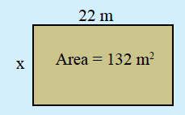


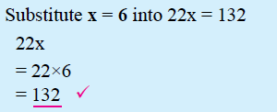
24
7
30
Problem Solving
Date:
EQ – How can we solve logical problems?
Problem: Solve for x
Step 1: Write out an equation
Step 2: Solve the equation
Step 3: Check your answer!
What are the steps to solving a problem?

Slide 6
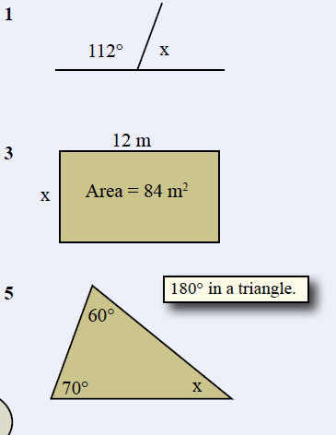
Task
Complete the following problems
Remember:
Step 1: Write out an equation
Step 2: Solve the equation
Step 3: Check your answer!
Notes:
Guide students through the question.
Option 2: Dot plots handout (Scaffolded for kids who may need extra help)

Slide 7
Pick a partner to work with
You may move to sit next to that person

Slide 8
Problem solving skills
You and your partner will work together to solve the following problems that the teacher is handing out.
Try and get through as many as you can.
Hint: draw diagrams, it will help you solve the problem
Those that get the most correct will earn 20 vivo points each!!
Notes:
Guide students through the question.
Option 2: Dot plots handout (Scaffolded for kids who may need extra help)

